Slide 1

My house
Unit 3

Slide 2
Overview
The rooms of the house.
Guess the picture.
Vision of 2030
Talk about their house.
At the end of this session, you will be able to:

Slide 3

What does your brother do?
He is open the front door.

Slide 4
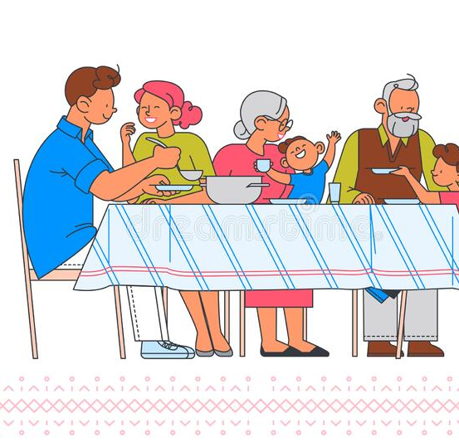
Where do you eat?
I eat in the dining room.

Slide 5
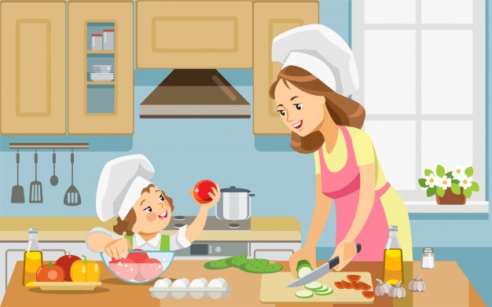
Where's your mother? She is in the kitchen

Slide 6
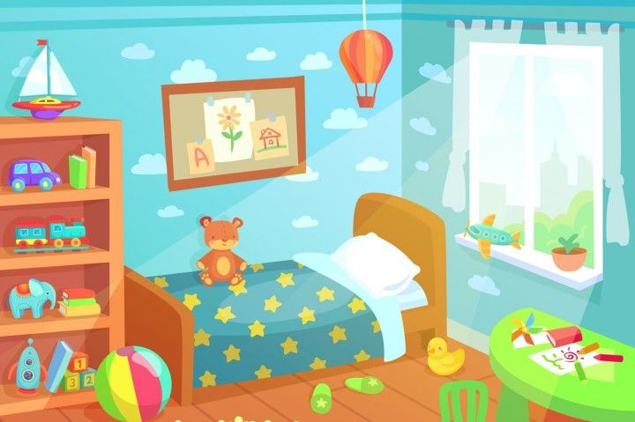
Where does your brother sleep?
He sleeps in the bedroom.

Slide 7
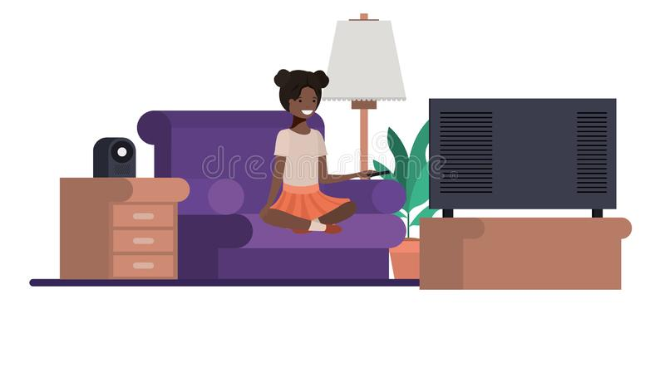
Where do you watch T.V? I watch T.V in the living room

Slide 8

Where does your sister take shower? She takes shower in the bathroom.

Slide 9
Exercise on Worksheet

Slide 10
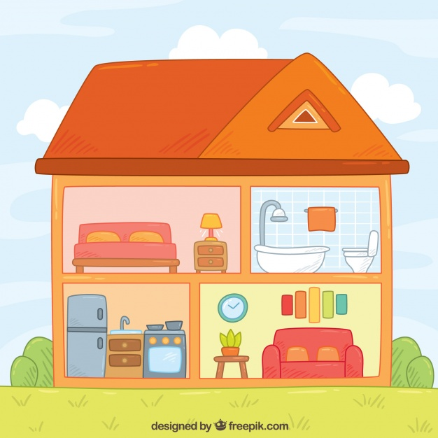
Review

Slide 11
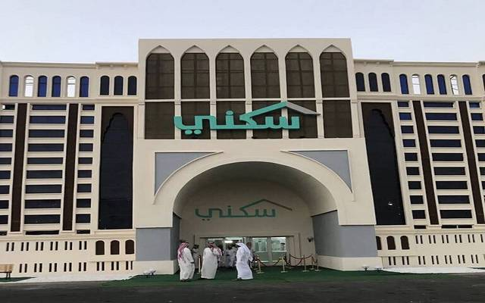
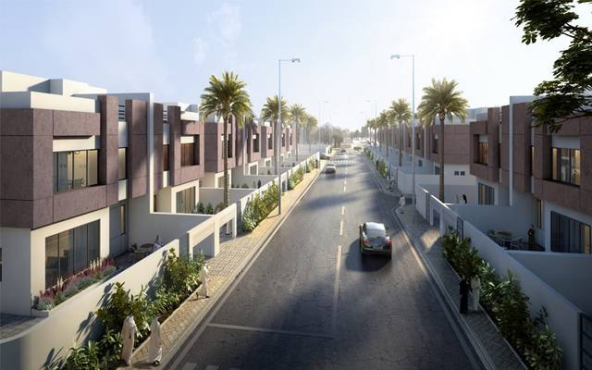
Vision رؤية2030
housing

Slide 12
THE END

